Slide 1


IT Ticket Analysis

Slide 2
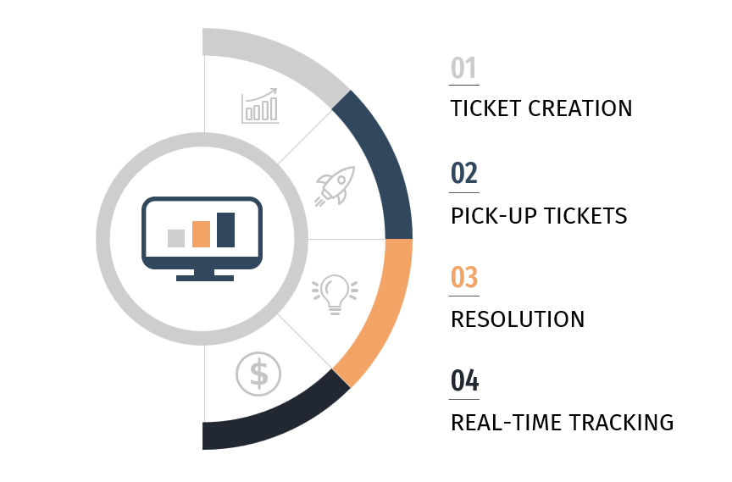
Introduction
Analyzed resolution times to uncover delays and improve efficiency.
Reviewed customer feedback to highlight service gaps and strengths.
Assessed agent performance to identify top performers and support needs.
Recommended training: staffing, and process improvements.

Slide 3
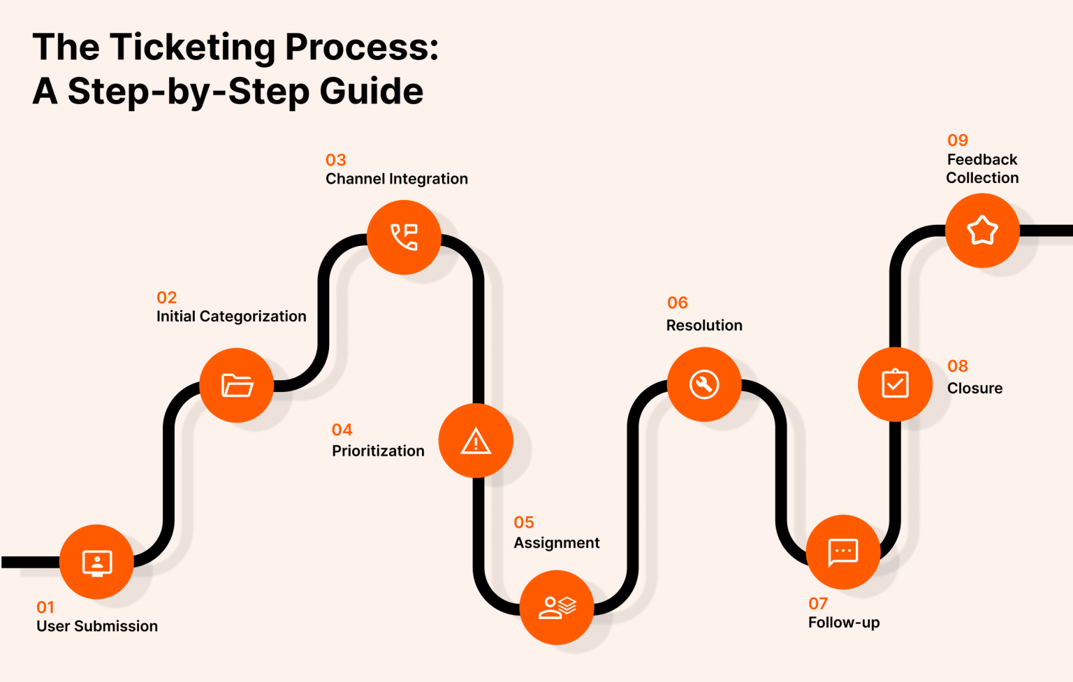
How its works

Slide 4

Problem Statement
Support tickets increased by 124% over five years.
Hardware, software, and system issues take longer to resolve than login-related tickets.
Lack of visibility into agent performance and resolution trends hinders informed decisions.
Employee satisfaction improved by only 4.15% despite rising demand.

Slide 5
    IT Management system Data Snapshot
Total Tickets: 97,498 IT tickets were logged across all categories.
Resolution Time vs Satisfaction: Most tickets are resolved within 0–5 days, with satisfaction rates ranging between ~4.0 to 4.12, indicating moderate employee satisfaction.
Category Breakdown:
Hardware: 9,733 tickets
Software: 19,570 tickets
System: 39,002 tickets
Login/Access: 29,193 tickets
Resolution Time vs Satisfaction: Most tickets are resolved within 0–5 days, with satisfaction rates ranging between ~4.0 to 4.12, indicating moderate employee satisfaction.

Slide 6
    IT Management system Data Snapshot
Request Category Resolution Times:
Hardware: 7.6 days (longest)
System: 6.6 days
Software: 5.2 days
Login/Access: 0.3 days (fastest)
Team Performance Trends: Overall performance shows gradual improvement over months, with satisfaction rates trending upward, peaking at ~8,495 (performance metric).
Top 5 Average Performers: Agents with IDs 19, 6, 25, 28, and 3 show average resolution times of 5.0–5.4 days and satisfaction rates of 3.0–3.6.

Slide 7
Analytical Approach & tools
Data Cleaning: Utilized functions like TRIM, CLEAN, and Remove Duplicates to ensure ticket data accuracy.
Data Enrichment: Enhanced dataset with additional variables such as agent details, priority levels, and SLA using VLOOKUP to cross-reference external sources.
Descriptive Analysis: Employed Pivot Tables to summarize ticket metrics, agent performance, and resolution efficiency across departments.
Trend Analysis: Conducted time series analysis using TREND and FORECAST functions to predict ticket volumes and resolution timelines.
Agent Performance Segmentation: Applied SORT and FILTER to classify IT agents into high, medium, and low performers based on KPIs.
Employee Satisfaction Analysis: Used weighted scoring and charts to assess and visualize employee satisfaction levels with IT support.

Slide 8
Analytical Approach & tools
Root Cause Analysis: Identify underlying causes of recurring issues to prevent future tickets and improve system reliability.
Response Time Optimization: Analyze first-response times and follow-up patterns to streamline communication and reduce ticket resolution delays.
Resource Utilization Analysis: Evaluate workload distribution among IT agents to detect overburdened staff and optimize staffing allocation.
Predictive Analysis: Use historical ticket trends to forecast future ticket volumes, anticipate resource needs, and proactively address potential bottlenecks
Visualization: Created dynamic charts and dashboards for data representation, enabling interactive exploration and insights-driven decision-making
Process Improvement Analysis: Identified recurring issues, delays, and bottlenecks using conditional formatting and calculated metrics.

Slide 9
Ticket Volume Trends
Insights:
The total support tickets rose from 13,051 in 2016 to 29,088 in 2020.
  This means the number of tickets increased by almost 123% over five years

Slide 10
Satisfaction rate by Time
Insights:-
Employee satisfaction has a strong inverse relationship with resolution time. The sharpest decline occurs after the initial point, making immediate resolution essential for a positive experience.
Quick resolution times strongly boost employee satisfaction.
Maximum satisfaction (103,016) happens when tickets are resolved within one day

Slide 11
Ticket By Priority
Insights:-
91% of tickets are labeled Normal priority, showing poor prioritization and software issues.
26,826 tickets are unassigned, indicating major workflow and management problems.

Slide 12
Average Resolution Time by Request Category, Quarter-wise
Insights:-
Recommend reviewing workflows and adding technical support to speed up resolutions.
System, hardware, and software tickets take the longest to resolve, causing delays.

Slide 13
Age Group by Satisfaction Rate
Insights:-
The age group 53–55 has the highest satisfaction rate at 4.41, indicating they likely have the most efficient resolution times.
The age group 35–37 has the lowest satisfaction rate at 3.64, suggesting room for improvement in their resolution performance.

Slide 14
Ticket by Severity Rate
Insights:-
A significant majority of tickets (88,656) fall under Normal severity, indicating routine support load
However, with 6,000+ Major and Urgent tickets, there is a critical need to prioritize high-impact issues effectively.
Over 6,000 Major and Urgent tickets highlight the need for better issue prioritization.

Slide 15
Distribution of Tickets Based on Satisfaction Score
Insights:-
A large majority of tickets received high satisfaction scores, with 50,770 tickets rated 5 and 27,562 rated 4, indicating strong overall customer satisfaction.
However, over 17,000 tickets received low scores (1–2), highlighting areas where support quality or resolution experience can be improved.

Slide 16
Distribution of Tickets Based on Resolution Time
Insights:-
Most tickets are resolved within a day, showing strong efficiency in handling quick issues.
However, as resolution time increases, the number of closed tickets drops sharply, indicating delays with more complex cases.
Resolution rates decline as time increases, pointing to struggles with complex problems.

Slide 17
Distribution of tickets based on Resolution time
Insights:-
System issues have the highest count with 39,002 tickets, showing it’s the most common problem area.
Hardware issues have the lowest count with only 9,733 tickets, while Login Access (29,193) and Software (19,570) fall in between.

Slide 18
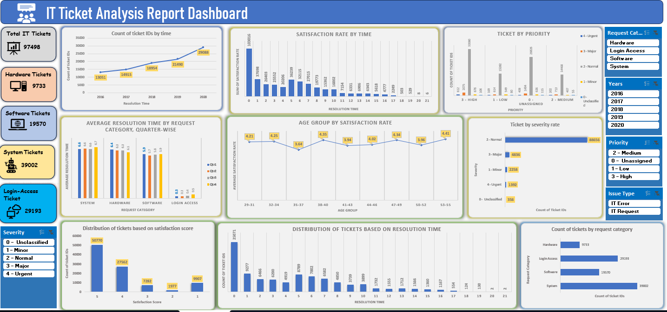
Dashboard Representation

Slide 19
Recommendations
Focus on faster resolutions to boost satisfaction—especially for tickets closed within 24 hours.
Refine priority handling to ensure critical issues get addressed without delay.
Provide targeted training to improve performance among lower-satisfaction age groups.
Allocate skilled resources to handle complex hardware and software tickets efficiently.

Slide 20
Conclusion
Identified High & Low Performers: Analysis highlights top-performing IT agents and those needing improvement.
Improved Efficiency Insights: Key patterns in ticket resolution times were uncovered
Employee Satisfaction Correlation: Satisfaction levels are directly influenced by response speed and resolution quality.
Ticket Volume Distribution: Analysis reveals which request types and employee age groups generate the highest ticket load
Actionable Recommendations: Insights guide targeted training, mentorship, and process improvements to boost overall team performance.

